Slide 1
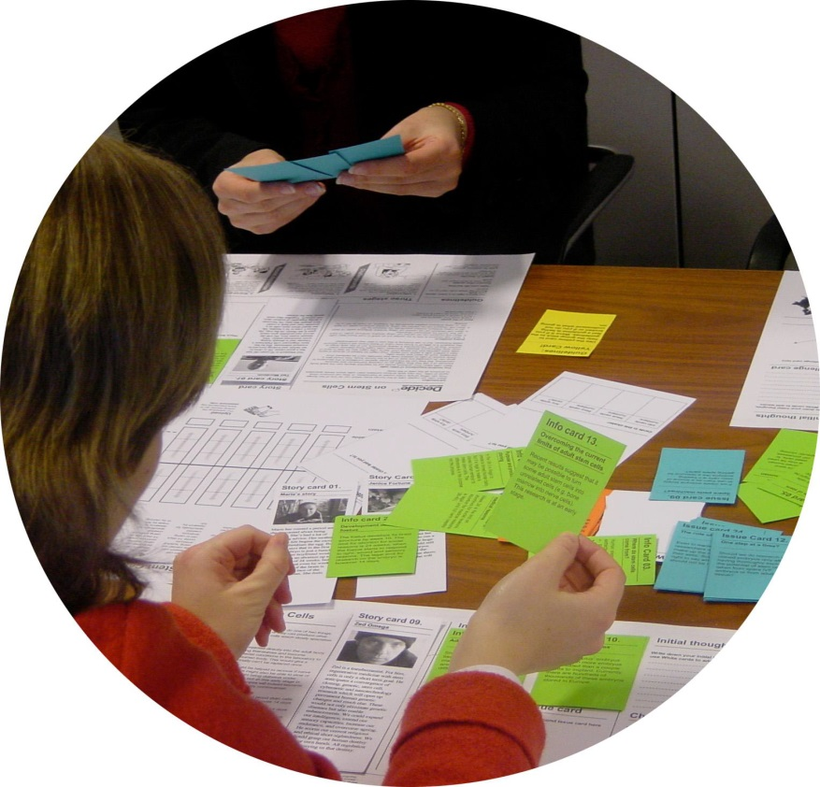
Monitoring and Implementation: Impact assessments and the role of citizen science

Slide 2


UK’s largest independent ‘think and do’ tank
Purpose: to bring about a Great Transition to a new economy and to improve quality of life
NEF is committed to developing practical methodologies and promotes the use of innovative and participative ways of working with the corporate, voluntary and public sectors.
“Economics as if people and the planet mattered”
Social enterprise founded and owned by NEF to help organisations put NEF’s ideas into practice.
We aim to prove and improve social, economic and environmental impact and put people and the planet at the heart of our work.

Slide 3
RELEVANCE OF NEF’S WORK
PARTICIPATION
IMPACT ASSESSMENT
CAPACITY BUILDING
My own planning/ SIA experience

Slide 4
PARTICIPATION
Our work is all about opening up debate, and we envisage a political culture where everyone has the skills, information, opportunities and right to contribute to decision-making processes.
Over the years NEF has developed a number of documents and toolkits to be used to encourage and enhance citizen participation
‘Participation works’ (NEF 1998) – techniques for participation, including:
Action Planning
Choices Method
Community Indicators

Slide 5
CAPACITY BUILDING
Building community capacity to measure local effect of neighbourhood renewal projects
Neighbourhood renewal projects not just about physical change - the effect of these projects on local people and 'social capital‘ important too
This handbook describes a method for local people to measure the effect of community projects on the relationships between them and on their quality of life.
Measuring develops practical skills such as doing surveys, interviewing people, and analysing information. It also encourages people to reflect on and learn from their experiences.
Prove it! Measuring the effect of neighbourhood renewal on local people (NEF 2000)

Slide 6
CAPACITY BUILDING
CO-PRODUCTION – about the delivery of public services
BUT not just about public services -
This is not about consultation or participation – except in the broadest sense. The point is not to consult more, or involve people more in decisions; it is to encourage them to use the human skills and experience they have to help deliver the services they are seeking
Devolve real responsibility, leadership and authority to ‘users’, and encourage self-organisation rather than direction from above
Co-production: A Manifesto for growing the core economy (NEF 2008)

Slide 7
IMPACT ASSESSMENT AT NEF
Commissioned by the Friends of Queens Market
Results showed that Queens Market was thriving, attracting an estimated 415,000 visitors each year. It is highly valued by customer and traders alike.
A number of threats to a thriving Queens Market were raised by the plans put forward by Newham Council and St Modwens
The East London Citizens Organisation (TELCO) conducted a wide-ranging independent enquiry into proposals to regenerate the market
Working alongside community groups to effect change
The world on a plate: Queens Market - The economic and social value of London’s most ethnically diverse street market (NEF 2006)

Slide 8

SOME REFLECTIONS ON IMPACT ASSESSMENT FROM NZ
http://www.conservationvolunteers.co.nz/

Slide 9
GROUP REFLECTION
What are some of the barriers to community participation? What are some options for addressing these barriers?
What type/s of capacity building would be useful for your community? i.e. what support is required?
Co-production and its emphasis on delivering public services could be seen as a purely top-down approach. How do you think co-production as a principle could be embraced by community groups?

Slide 10

THANK YOU
Charlotte Crack NEF Consulting For further information contact: charlotte.crack@nefconsulting.com

Slide 11
References
New Economics Foundation (1998) Participation Works! 21 techniques of community participation for the 21st century http://www.neweconomics.org/publications/entry/participation-works
New Economics Foundation (2000) Prove it! Measuring the effect of neighbourhood renewal on local people http://www.neweconomics.org/publications/entry/prove-it
New Economics Foundation (2006) The world on a plate: Queens Market The economic and social value of London’s most ethnically diverse street market. http://b.3cdn.net/nefoundation/31f21886832eb6ba1a_15m6ba8x3.pdf
New Economics Foundation (2008) Co-production: A Manifesto for growing the core economy http://www.i-r-e.org/docs/a008_co-production-manifesto.pdf

