Slide 1

RUSS Community Land Trust
Tony Rich
Vice-chair

Slide 2
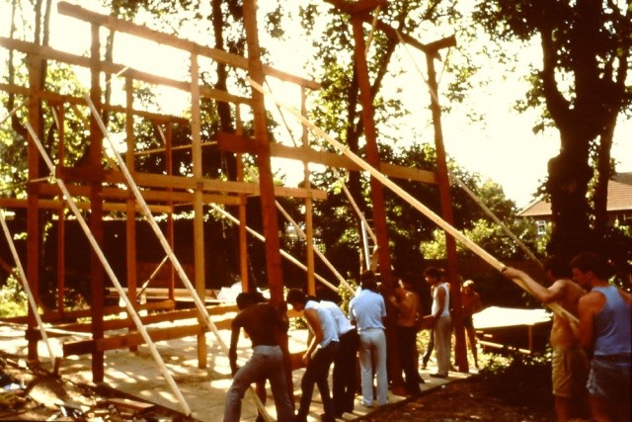
Origins of RUSS –Walter Segal homes

Slide 3
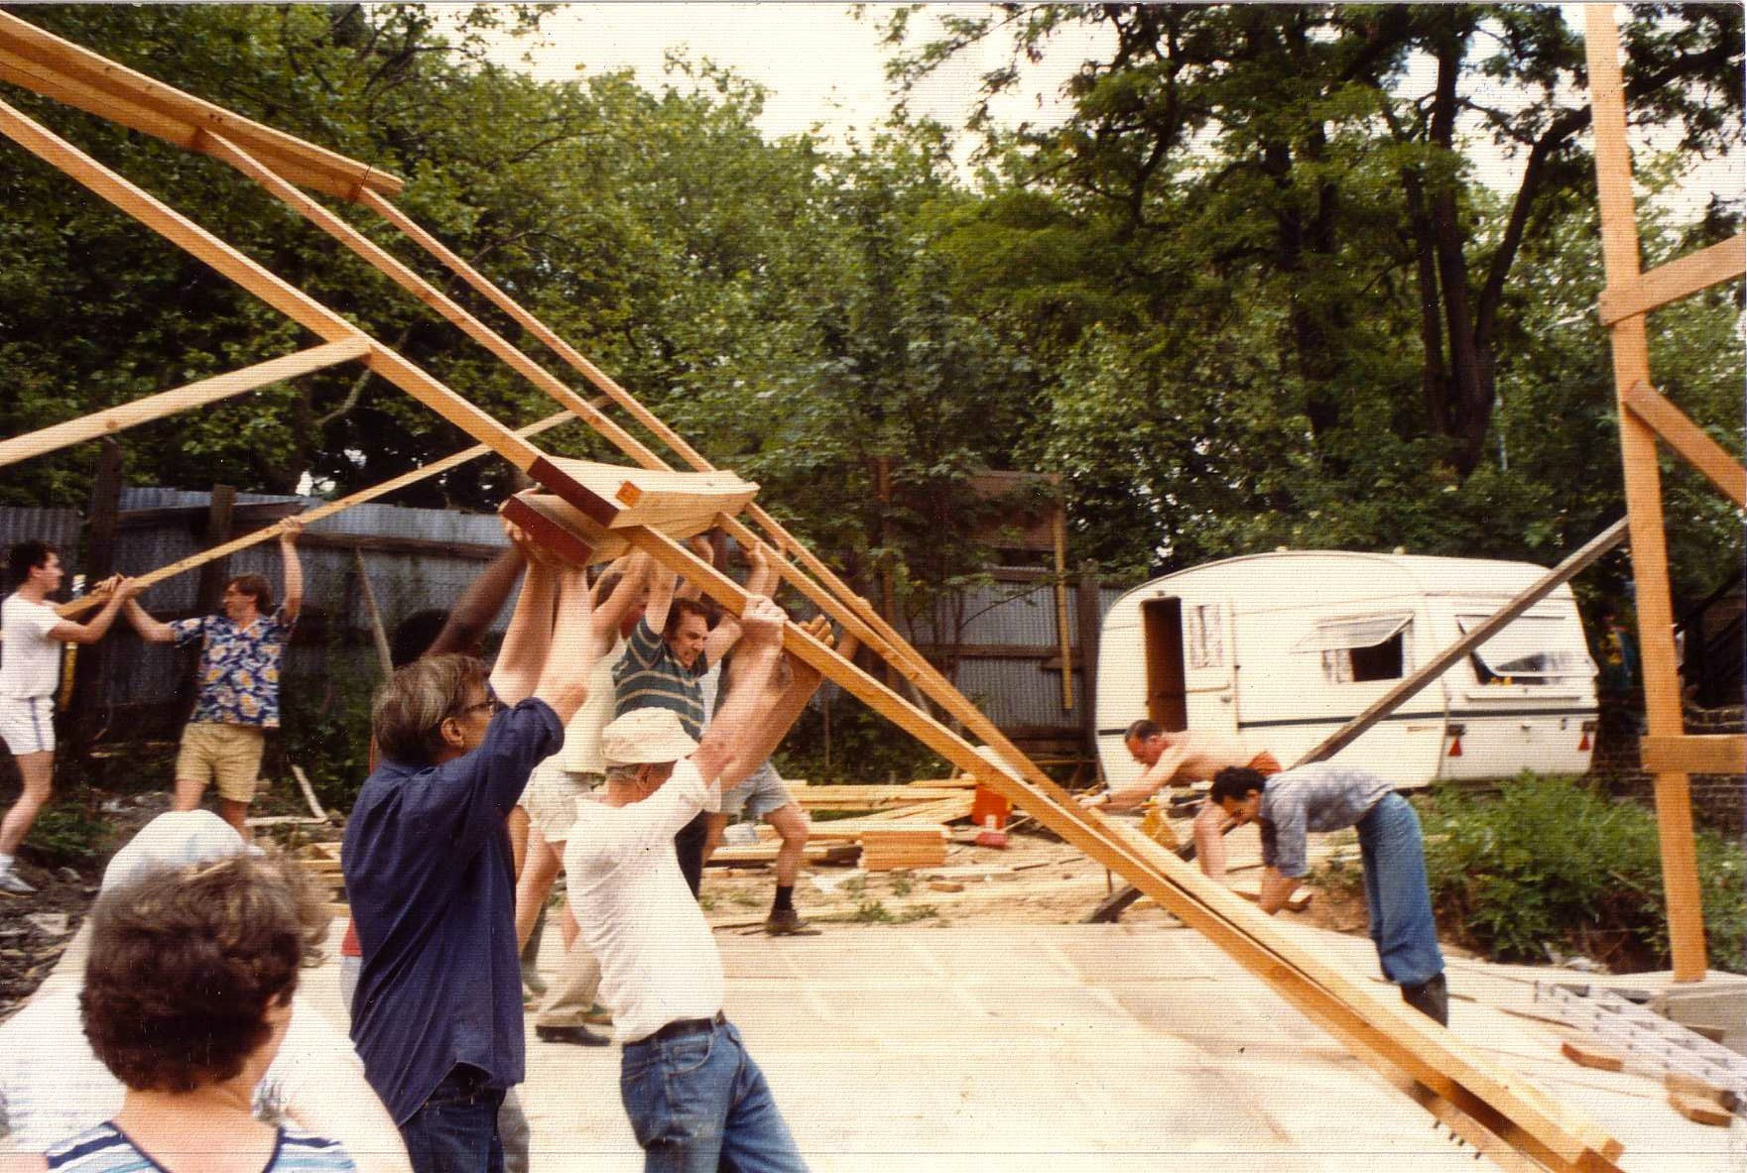

Slide 4
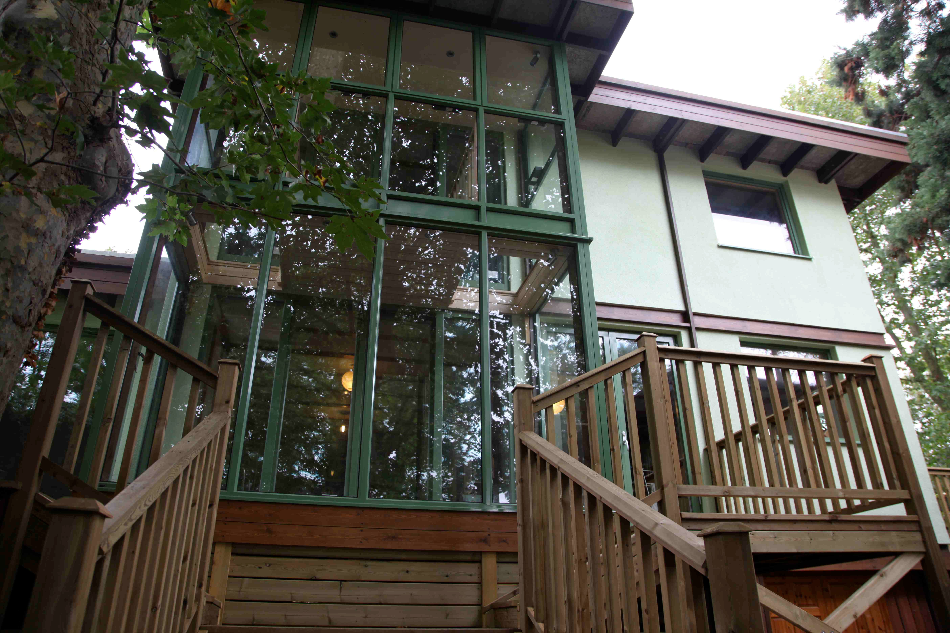
The end product…

Slide 5
What are Community Land Trusts (CLTs)?
set up to benefit a defined community
not-for-private-profit. This means that they can, and should, make a surplus as a community business, but that surplus must be used to benefit the community
local people living and working in the community must have the opportunity to join as members
members control the CLT (usually through a board being elected from the membership).
Notes:
Includes;
CLH is a wide field including: charities, Almshouses, Registered Providers, Tenant Management Organisations (TMOs), Housing Co-operatives, Self Help Housing Organisations, Development Trusts, Community Land Trusts (CLTs) and Cohousing Communities

Slide 6
What role can CLH play?
Many homes being built do not match local needs- e.g. are unaffordable due to high land values or seen as ‘unviable’ due to low land/property values
CLH sector currently represents only approx. 1% of overall provision (compared to between 5-15% in the rest of Europe)
800 CLT homes completed to date with approximately 370 homes now being built each year
CLT Network estimates that 4,000 affordable homes are in the pipeline

Slide 7
Industrial Provident Society for Community Benefit formed in 2009
Over 750 members (£1 for life)
Planning application submitted for first site in Lewisham (Church Grove) for a scheme of 33 affordable homes
Project is co-housing – i.e. there is a community space built in the development
Includes opportunities for ‘self-build’ or ‘self-finish’
Homes will be built to Passiv Haus standards
Notes:
RUSS – or the Rural/ Urban Synthesis Society – is a volunteer-led community land trust based in SE London founded in 2009, which aims to create sustainable neighbourhoods with truly affordable homes, offering opportunities for residents where they want to, to self-build. The first RUSS project is an area of land in Lewisham which is to be transferred to the CLT by the local authority for £1 and on which RUSS will build 33 affordable homes by 2018.

Slide 8
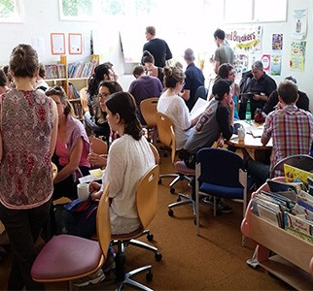
RUSS School of Community-led Housing
RUSS runs regular affordable workshops for individuals and groups wanting to start their own project
Go to https://www.theruss.org/school-of-community-led-housing/ to register interest in future workshops

Slide 9
Church Grove Project
33 homes - 14 for affordable sale, 12 for part-ownership, 2 shared houses for affordable rent and 5 socially rented homes for families on LBL waiting list
RUSS will retain 20% stake in homes to ensure affordability in perpetuity
Purchase and rental costs pegged to average earnings in the area
Amount paid reduced if the resident carries out self-build/self-finish

Slide 10
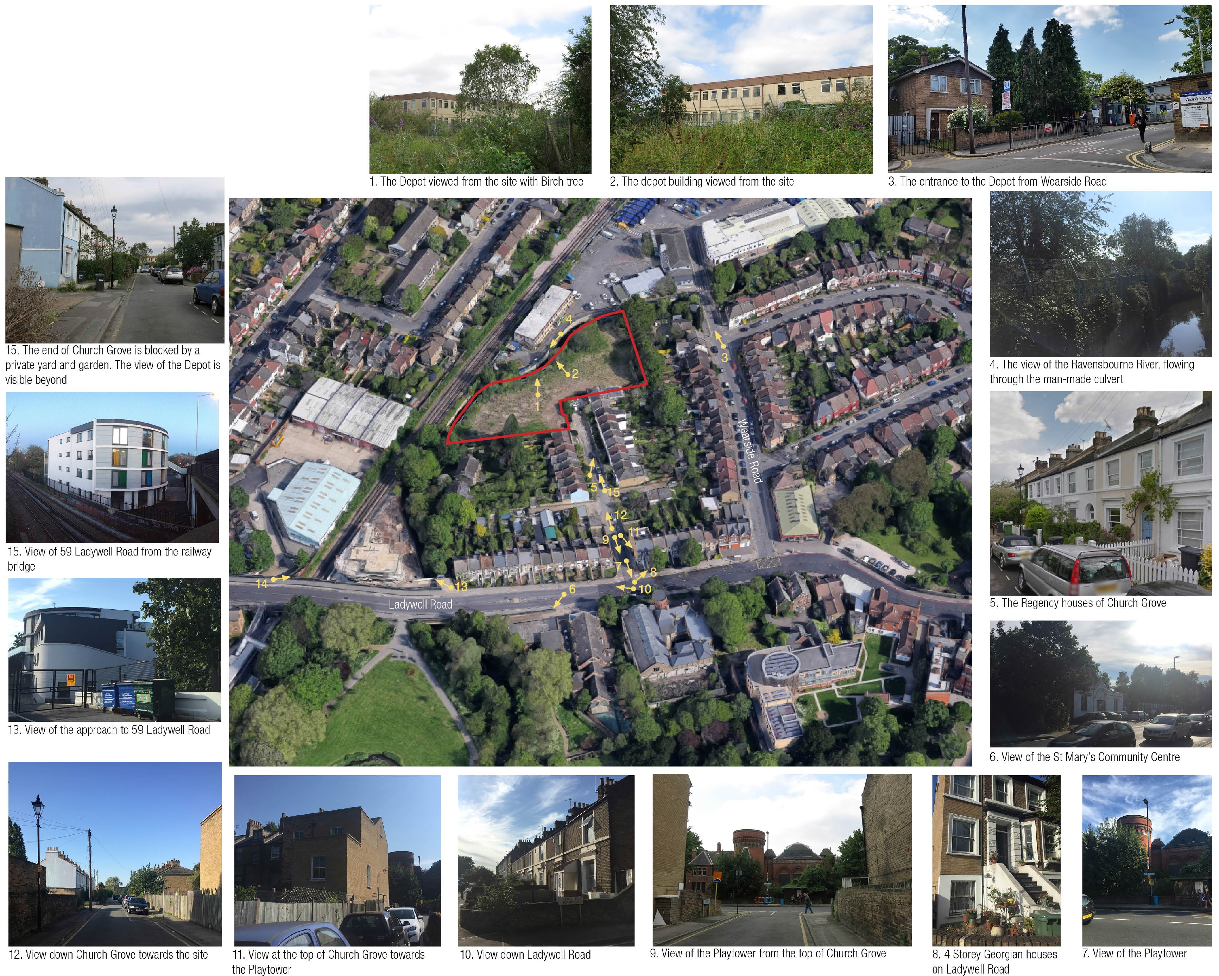
Church Grove site

Slide 11
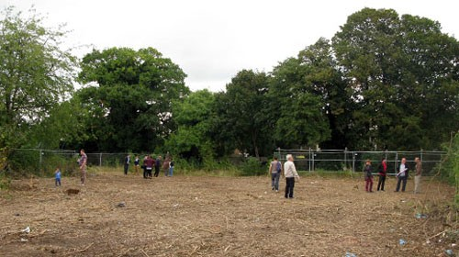
Church Grove site

Slide 12
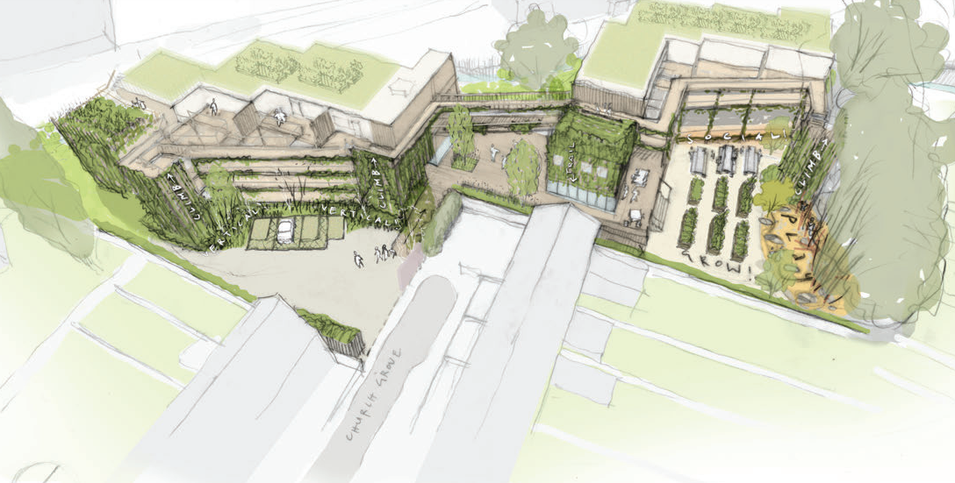
Church Grove –view from South

Slide 13
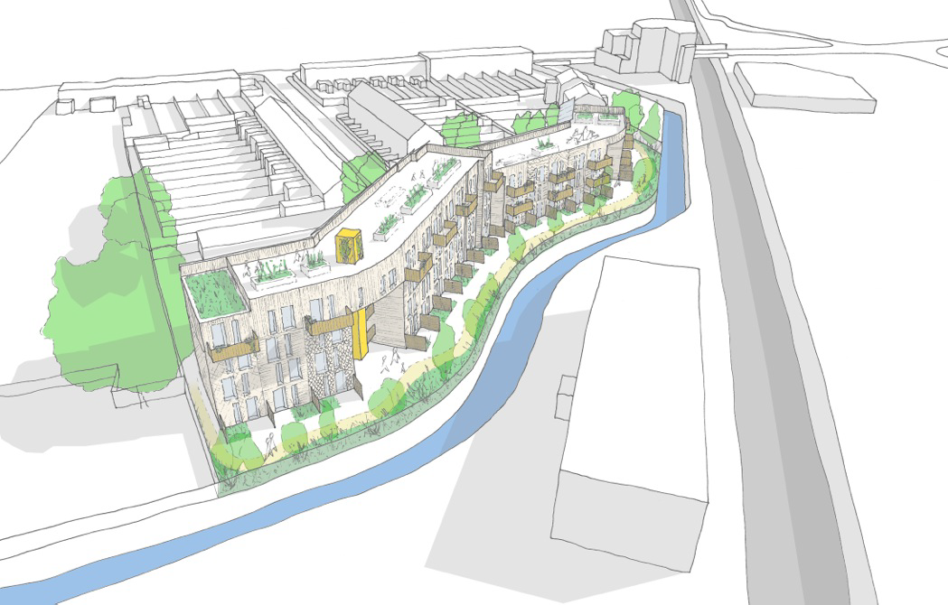
Church Grove view from the North

Slide 14
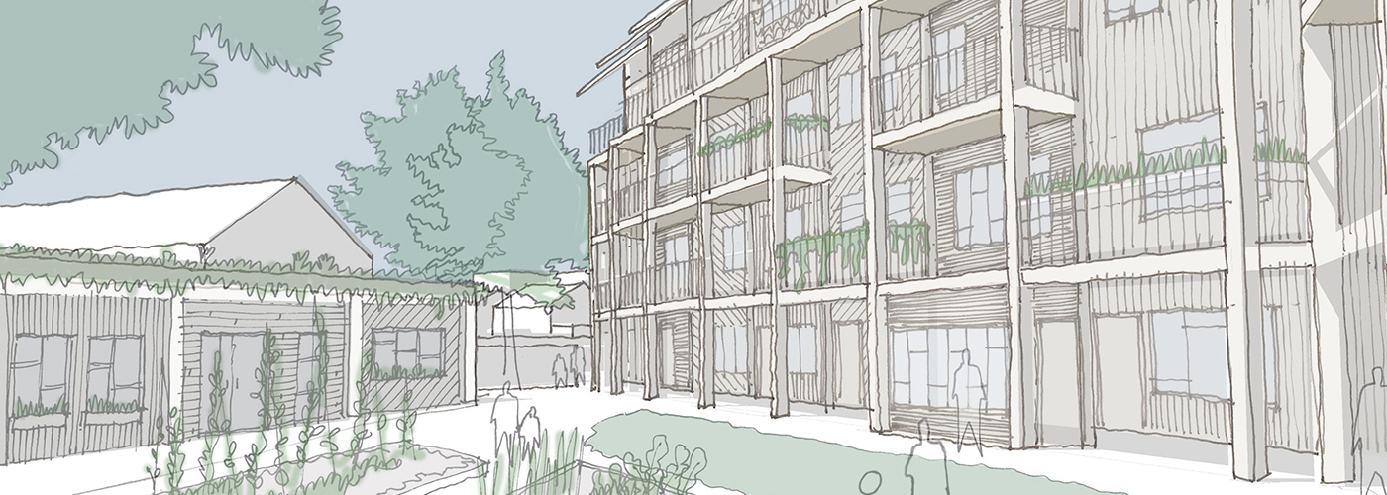
Church Grove visuals

Slide 15
How we could do more of it - what CLTs need
A pipeline of developable (not necessarily prime) sites available at low or preferably nil cost
Multi-year start up grants – many CLTs are run by volunteers which can cause burn-out. Grants can enable staff to be employed
Broader range of low-interest development loans on affordable terms which recognise non-mainstream models of home building e.g. including self-build

Slide 16
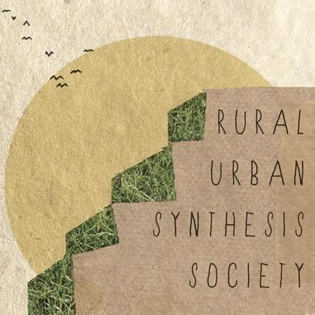
tonyjrich@gmail.com
www.theruss.org

